Slide 1
Reaction Turbines a. Propeller b. Kaplan Turbine
Rudra Ghimire

Slide 2
Specific speed:
The Specific Speed Ns of a turbine is the speed in rotations per minute (rpm.) at which a similar model of the turbine would run under a head of 1m. when of such size as to develop 1 kW.
(Note: The suffix "s" is used to denote the values associated with the Specific Turbine)
Each type of Turbine (Pelton Wheel, Francis etc.) has it's own characteristic limits of Ns.

Slide 3
Specific speed:
Turbine Speed
Most of the turbines, generator and powerhouse dimensions are based on speed of turbine
generator either coupled directly or through a speed increaser to the turbine, should reach the synchronous speed.

Slide 4
Where N_{s} = specific speed
N = turbine speed in revolution per minute
H_{d} = design head of turbine in meter
P = turbine power in kilowatts

Slide 5
The selected turbine speed should also be at synchronous speed which, for a 50-H_{Z} system, is obtained from the relationship.
Where, f = frequency, 50 Hz.

Slide 6
Table: 2 Specific Speed and head range for different turbines
S.N. | Turbine type | Range of specific Speed | Range of head | Range of runaway speed, rpm
1 | Kaplan | 300 – 1000 | 4 m to 40 m | 2.0 to 2.2 x normal speed
2 | Francis | 50 – 450 | 30 m to 450 m | 1.9 to 2.2 x normal speed
3 | Pelton | 10 – 70 | 100 m to 2000 m | 1.8 to 1.9 x normal speed
4 | Cross-flow | 20 – 70 | 5 m to 200 m | 1.8 to 2.0 x normal speed
5 | Turgo | 20 – 80 | 30 m to 300 m | 1.9 to 2.0 x normal speed

Slide 7
The general efficiency trends for different types of turbines and their best efficiency for calculation purpose is presented in Table 3
Turbine type | General efficiency trend | Best efficiency
Kaplan | Good efficiency range for full and part load condition and can be operated up to 20% load. | 0.91
Francis | Full load efficiency is good and part load efficiency is poor and not recommends operating below 50% load. | 0.92 to 0.94
Pelton | Good efficiency range for full and part load condition and can be operated up to 30% load. | 0.90
Cross flow | Good efficiency range for full and part load condition and can be operated up to 30% load. | 0.80
Turgo | Good efficiency range for full and part load condition and can be operated up to 25% load. | 0.85

Slide 8
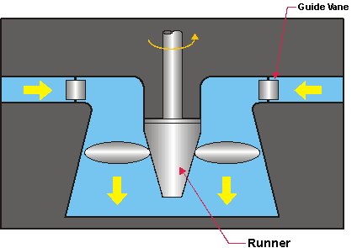
PROPELLER TURBINE
Propeller turbine is an axial-flow reaction turbine .
Propeller-like runner having three to six runner blades depending on the design water head.
Three for low head and six for high head.

Slide 9
CONTD.
Especially designed for low heads with large volume of water -2 meters and 30 meters.
It operates like a boat propeller but in a reverse mode.
The shaft is generally vertical.
The runner blades are fixed and non-adjustable
One type of propeller turbine called the Kaplan turbine has adjustable blade pitch.

Slide 10
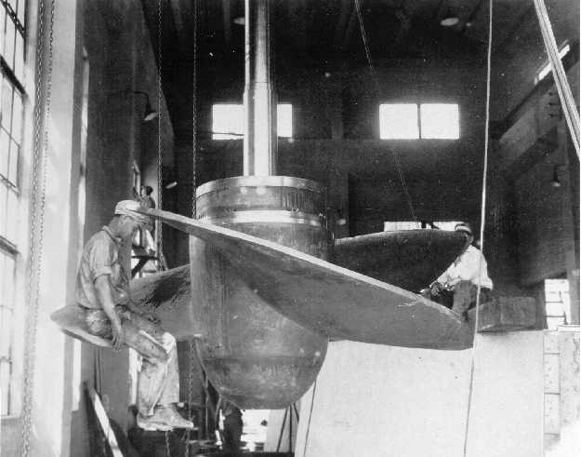
CONSTRUCTION
Consists of
Shaft
Axial flow runner
Hub
Air-foil shape blades
Spiral casing
Draft tube
Vertical shaft
Runner
Hub
Blade

Slide 11
ADVANTAGES
DISADVANTAGE
Less part load efficiency.
Absence of adjustable blades.
The loading on the blades are large due to few number of blades
Fabricated with low cost.
Smaller contact area cause less friction.
Low frictional losses since small number of blades.
The Kaplan or propeller type turbines can be mounted at almost any angle, but this is usually vertical or horizontal.
Have fewer blades than of Francis turbine so has less spacing of trash bars and impurities.

Slide 12
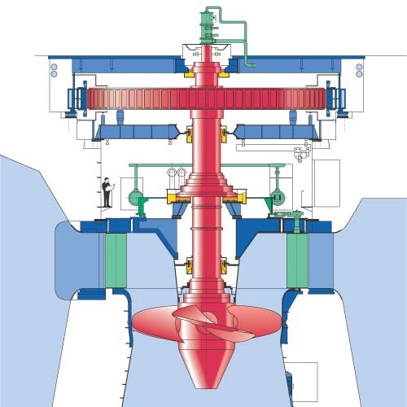

Slide 13
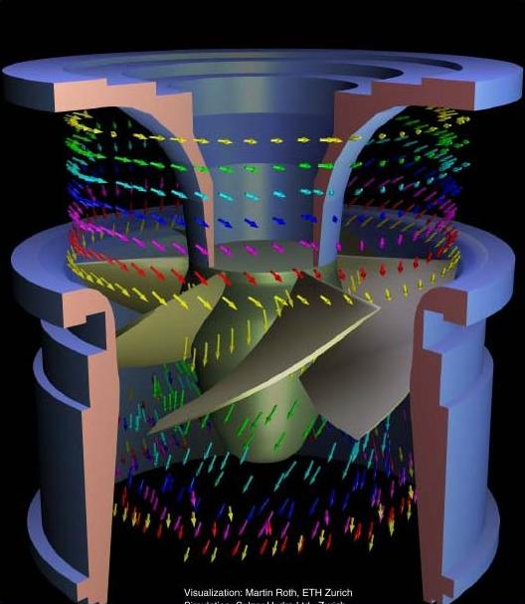

Slide 14
Kaplan Turbine
The kaplan turbine is a great development of early 20th century.
Invented by Prof. Viktor Kaplan of Austria during 1913 – 1922.
The Kaplan is of the propeller type, similar to an airplane propeller.
The difference between the Propeller and Kaplan turbines is that the Propeller turbine has fixed runner blades while the Kaplan turbine has adjustable runner blades.
It is a pure axial flow turbine uses basic aerofoil theory.
The kaplan's blades are adjustable for pitch and will handle a great variation of flow very efficiently.
They are 90% or better in efficiency and are used in place some of the old (but great) Francis types in a good many of installations.
They are very expensive.
The kaplan turbine, unlike all other turbines, the runner's blades are movable.
The application of Kaplan turbines are from a head of 2m to 40m.

Slide 15
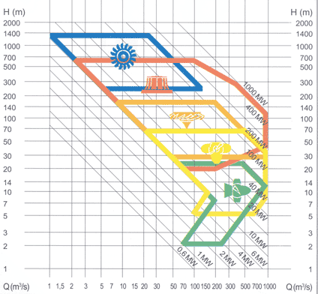
Francis to Kaplan

Slide 16
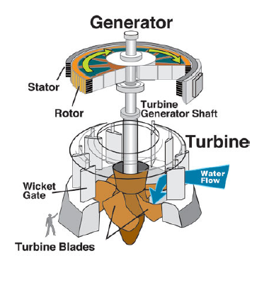
The Schematic of Kaplan Turbine

Slide 17
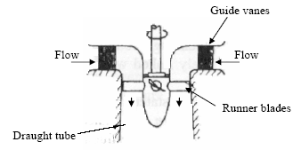
Major Parts of A Kaplan Turbine

Slide 18
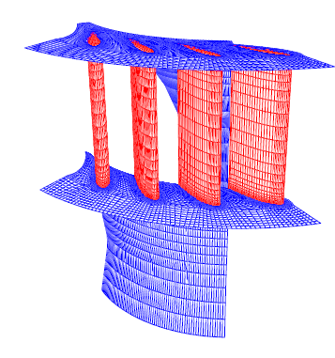
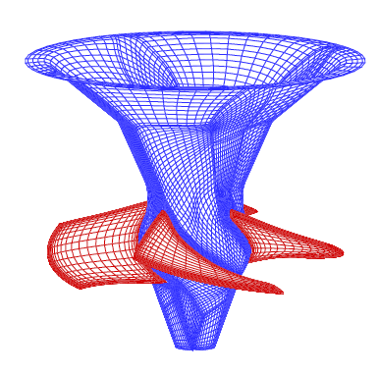
Superior Hydrodynamic Features
Essential for High Efficiency at low Heads
Section of Guide Wheel
Runner

Slide 19
Classification of Kaplan Turbines
The Kaplan turbine can be divided in double and single regulated turbines.
A Kaplan turbine with adjustable runner blades and adjustable guide vanes is double regulated while one with only adjustable runner blades is single regulated.
The advantage of the double regulated turbines is that they can be used in a wider field.
The double regulated Kaplan turbines can work between 15% and 100% of the maximum design discharge;
the single regulated turbines can only work between 30% and 100% of the maximum design discharge.

Slide 20
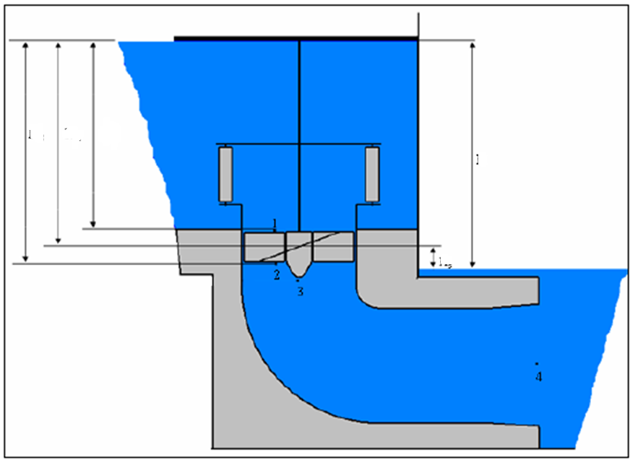
Hydraulic Energy Diagram
H_{m}
H_{ri}
H_{re}
H_{total}
H_{s}

Slide 21
The suction head
The suction head H_{s} is the head where the turbine is installed;
if the suction head is positive, the mean line of turbine is located above the trail water;
if it is negative, the mean line of turbine is located under the trail water.
To avoid cavitation, the range of the suction head is limited.
The maximum allowed suction head can be calculated using the following equation:

Slide 22
CAVITATION
Cavitation occurs especially at spots where the pressure is low.
In the case of a Kaplan turbine, the inlet of the runner is quite susceptible to it.
At parts with a high water flow velocity cavitation might also arise.
The major design criteria for blades is : Avoid Cavitation.
First it decreases the efficiency and causes crackling noises.
The main problem is the wear or rather the damage of the turbine’s parts such as the blades.
Cavitation does not just destroy the parts, chemical properties are also lost.

Slide 23
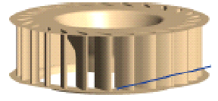
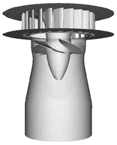
Design of Guide Wheel
D_{go}
k_{ug} 1.3 to 2.25 : Higher values for high specific speeds
Number of guide vanes : 8 to 24 : Higher number of vanes for large diameter of guide wheel.

Slide 24
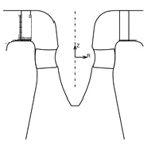
Outlines of Kaplan Runner
a
b
Guide Vanes
Whirl Chamber
The space between guide wheel outlet and kaplan runner is known as Whirl Chamber.
a=0.13 D_{runner} & b=0.16 to 0.2 D_{runner}.

Slide 25
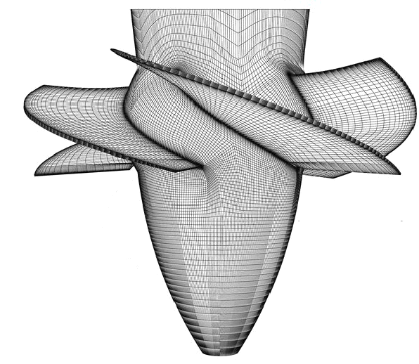
Design of Kaplan Runner
D_{runner}
D_{hub}

Slide 26
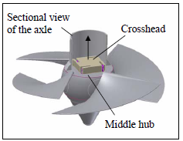
The Kaplan Runner

Slide 27
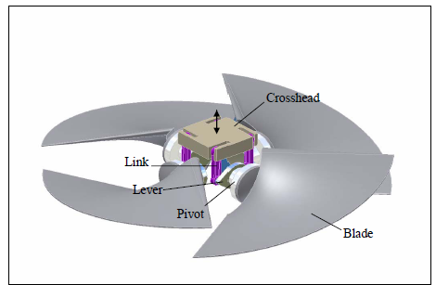
Adaptation Mechanism inside the Hub

Slide 28
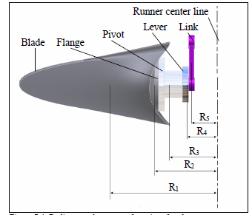
Inside the Hub

Slide 29
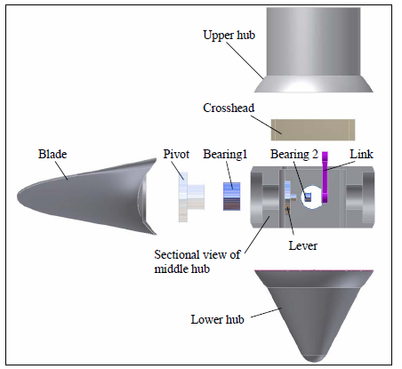
Parts of Runner

Slide 30
Hub diameter
The hub diameter D_{i} can be calculated with the following equation:

Slide 31
Runner diameter section
The runner diameter can be calculated by the following equation:

Slide 32
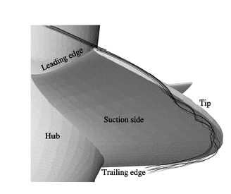
Hydrodynamics of Kaplan Blade

Slide 33
Draft Tube

Slide 34
Introduction
In the Pelton/T (impulse) the loss of energy due to exit velocity varies from 1 to 4%.
This exit energy varies from 4 to 25% for mixed flow turbines and from 20 to 50% of the total head for axial flow turbines.
With the increase in the value of specific speed Ns, the exit velocity energy V2²/2g increases compared with H (the available energy).

Slide 35
Introduction
Necessary to find a way out to extract this energy
An expanding pressure conduit (DT) hermetically fixed at runner outlet and having the other end below the maximum tail water level helps to convert the velocity head into pressure or potential head.
It is possible to have the pressure at runner outlet much below the atmospheric pressure.

Slide 36
Introduction
At rated load, the velocity at the upstream end of the tube for modern units ranges from 7 to 9 m/s, representing from 2.7 to 4.8 m head loss.
Good practice limits the velocity at the discharge end of the tube from 1.5 to 2.1 m/s, representing less than 0.3 m velocity head loss.

Slide 37
Purposes
To be set above tail- water level, without loss of head, to facilitate inspection and maintenance.
It regains, by diffuse action, the major portion of the kinetic energy delivered to it from the runner.

Slide 38
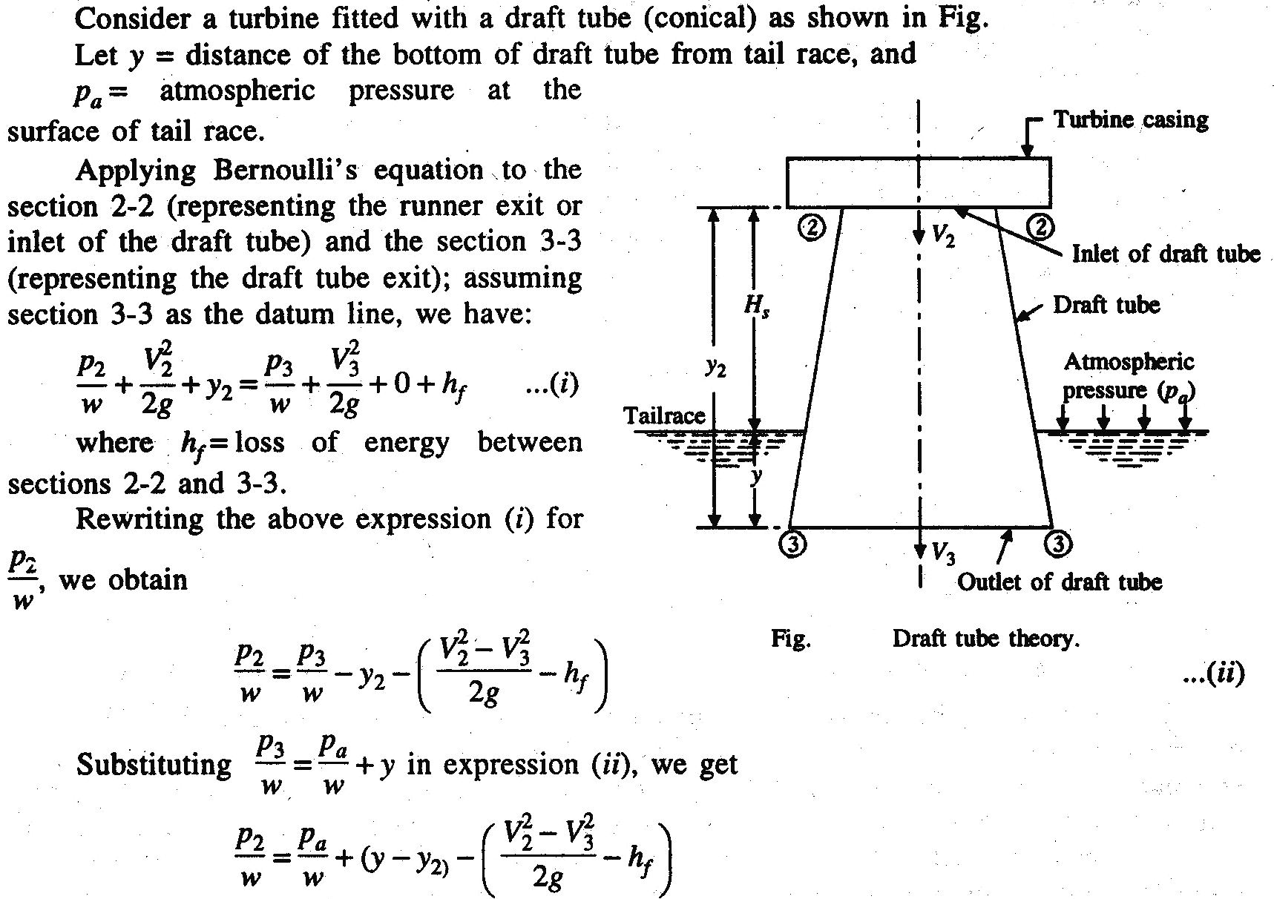
THEORY

Slide 39
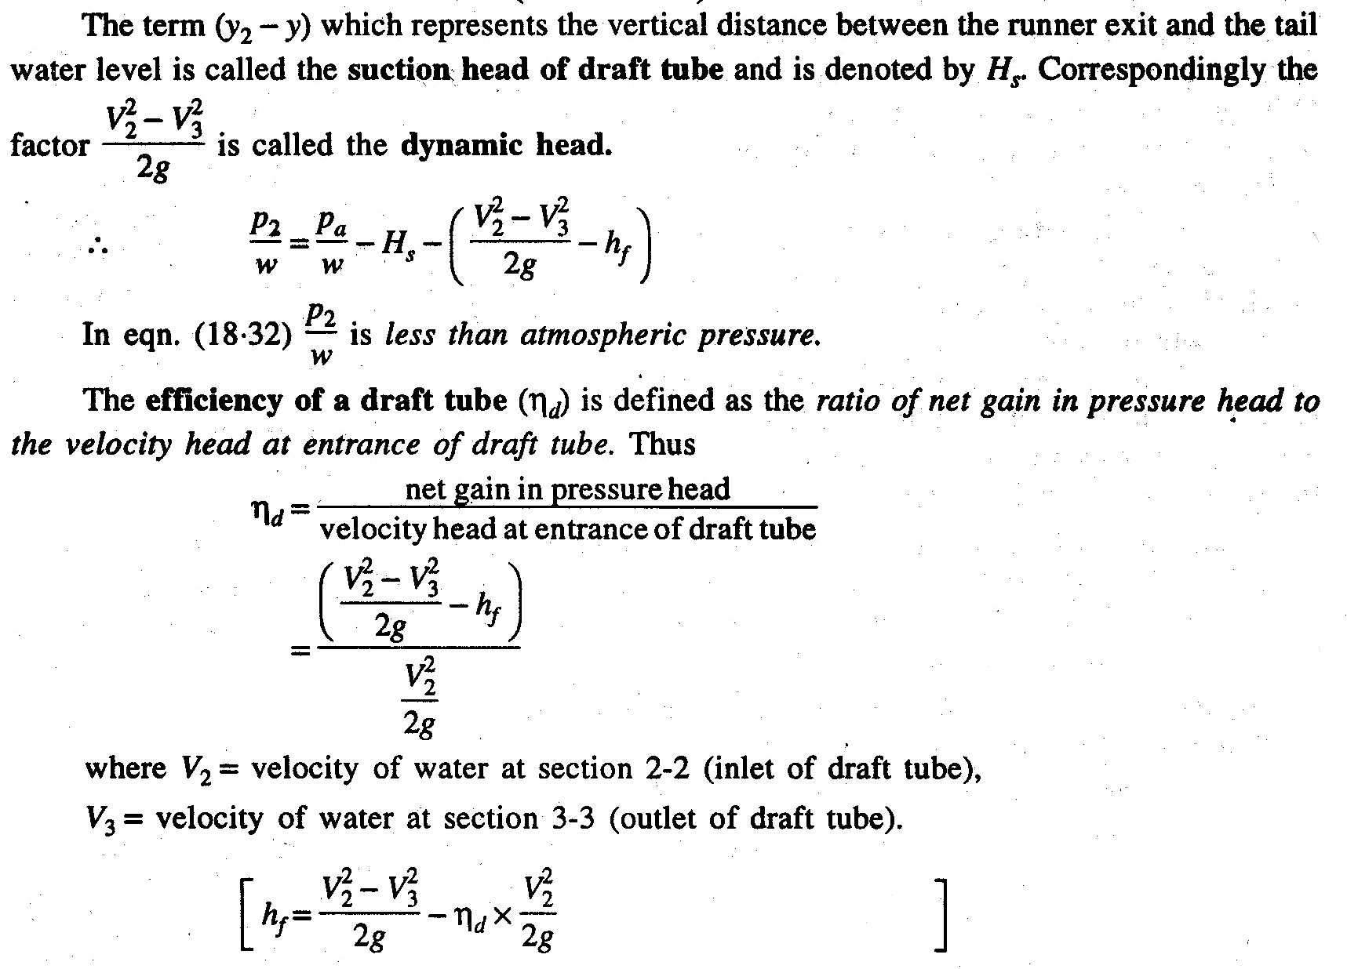

Slide 40
Types of draft tubes:
The straight conical or concentric tube
The elbow type
Moody spreading draft tube
Efficiency, over 85 percent

Slide 41
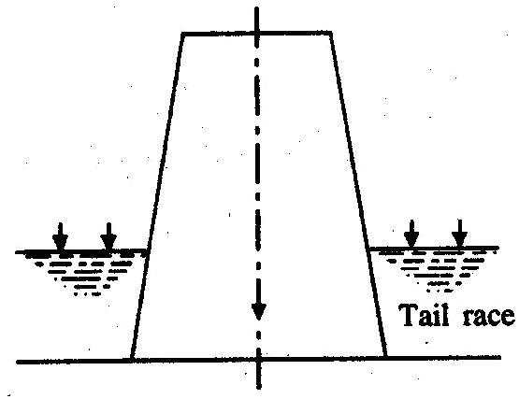
Straight conical or concentric tube
It is used on low-powered units for all specific speeds, frequently, on large-head units.
The side angle of flare ranges from 4 to 6°, the length from 3 to 4 times the diameter and the discharge area from 4 to 5 times the throat area.

Slide 42
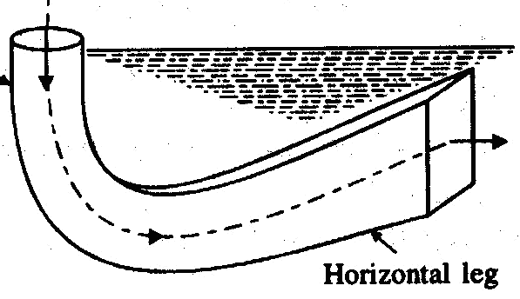
Elbow type
In most turbine installations.
Is designed to turn the water from the vertical to the horizontal direction with a minimum depth of excavation and at the same time having a high efficiency.
The transition from a circular section in the vertical leg to a rectangular section in the horizontal leg takes place in the bend.

Slide 43
Elbow type
The horizontal portion of the draft tube is generally inclined upwards to lead the water gradually to the level of the tail race and to prevent entry of air from the exit end.
The exit end of the draft tube must be totally immersed in water.
One or two vertical piers are placed in the horizontal portion of the tube, for structural and hydraulic reasons.

Slide 44
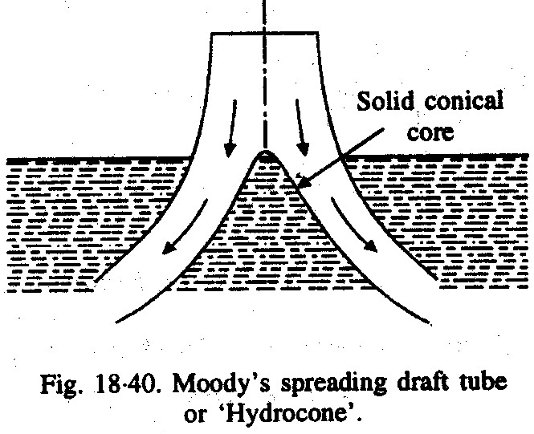
Moody spreading draft tube
It is provided with a solid central core of conical shape which reduces whirling action of discharge water.
It is suited particularly for helical flows which occur when the water leaves the runner with a whirl component.

Slide 45
Thank you

